Slide 1
IBM Z Open Automation Utilities V1.0.0

Slide 2
Disclaimer
IBM’s statements regarding its plans, directions, and intent are subject to change or withdrawal without notice and at IBM’s sole discretion.
Information regarding potential future products is intended to outline our general product direction and it should not be relied on in making a purchasing decision.
The information mentioned regarding potential future products is not a commitment, promise, or legal obligation to deliver any material, code or functionality. Information about potential future products may not be incorporated into any contract.
The development, release, and timing of any future features or functionality described for our products remains at our sole discretion.
Performance is based on measurements and projections using standard IBM benchmarks in a controlled environment. The actual throughput or performance that any user will experience will vary depending upon many factors, including considerations such as the amount of multiprogramming in the user’s job stream, the I/O configuration, the storage configuration, and the workload processed. Therefore, no assurance can be given that an individual user will achieve results similar to those stated here

Slide 3
Why Z Open Automation Utilities
Job Control Language (JCL) has been used for a long time for performing or automating a set of steps on the z/OS operating system.
Though JCL has evolved with the times, it is foreign to people familiar with environments such as Linux, UNIX, and Windows.
z/OS developers can write scripts to automate tasks in the UNIX System Services (USS) environment.
But there are gaps in what can be accomplished from USS i.e. accessing data sets or running MVS programs

Slide 4
How can ZOA Utilities help
ZOA Utilities fills in the gaps by providing the underlying runtime to support executing automation tasks on z/OS via Java, Python, and shell commands from USS.
With ZOA Utilities, you can run traditional MVS commands, such as IEBCOPY, IDCAMS, and IKJEFT01, as well as perform a number of data set operations in the scripting language of your choice.
ZOA Utilities is useful for z/OS developers who want to automate tasks that access MVS resources.

Slide 5
Example – Copy four files from HFS to PDSE
JCL
//*
//DCPI EXEC PGM=IEBGENER
//SYSIN DD DUMMY
//SYSPRINT DD SYSOUT=*
//SYSUT1 DD PATH='/tmp/interest.cobol', +
// RECFM=FB,LRECL=80,BLKSIZE=32720
//SYSUT2 DD DSN=@@HLQ@@.ZOASAMP.PROJ23.COBOL(INTEREST),DISP=SHR
//DCPB EXEC PGM=IEBGENER
//SYSIN DD DUMMY
//SYSPRINT DD SYSOUT=*
//SYSUT1 DD PATH='/tmp/mobile.cobol', +
// RECFM=FB,LRECL=80,BLKSIZE=32720
//SYSUT2 DD DSN=@@HLQ@@.ZOASAMP.PROJ23.COBOL(MOBILE),DISP=SHR
//DCPM EXEC PGM=IEBGENER
//SYSIN DD DUMMY
//SYSPRINT DD SYSOUT=*
//SYSUT1 DD PATH='/tmp/mortgage.cobol', +
// RECFM=FB,LRECL=80,BLKSIZE=32720
//SYSUT2 DD DSN=@@HLQ@@.ZOASAMP.PROJ23.COBOL(MORTGAGE),DISP=SHR
//DCPP EXEC PGM=IEBGENER
//SYSIN DD DUMMY
//SYSPRINT DD SYSOUT=*
//SYSUT1 DD PATH='/tmp/payment.cobol', +
// RECFM=FB,LRECL=80,BLKSIZE=32720
//SYSUT2 DD DSN=@@HLQ@@.ZOASAMP.PROJ23.COBOL(PAYMENT),DISP=SHR
Shell
dcp /tmp/*.cobol "${HLQ}.PROJ23.COBOL"
Java
Datasets.copy("/tmp/*.cobol", HLQ+".PROJ23.COBOL");
Python
Datasets.copy(source="/tmp/*.cobol",
target="%s.PROJ23.COBOL" % HLQ))

Slide 6
Run commands from a USS command line
ZOA Utility shell commands are designed for programmers familiar with Linux and UNIX
The commands have a name and syntax that is familiar to UNIX developers. Ex. the dls command lists data sets and is modeled on the UNIX ls command.
The ZOA Utility commands are true UNIX System Services commands
Piping and redirection of stdin, stdout, and stderr is supported.
This makes it easy and natural to incorporate the ZOA commands into shell and bash scripts requiring no complex dependencies.
Man page documentation is provided for the ZOA Utility commands and are accessed the same as any other UNIX man pages.

Slide 7
Shell Script Example
echo "Write 3 records to master dataset"
decho "Charles Field 278 323 6045" "${master}"
decho -a "David George 397 132 6025" "${master}"
decho -a "William Young 178 333 5045" "${master}"
echo "Write 3 records to new dataset"
decho "Emma Hill 149 589 5045" "${new}"
decho -a "Sharon Miller 153 232 6045" "${new}"
decho -a "Steve Green 748 111 6025" "${new}"
echo "Write the command string to the command dataset"
decho " MERGE FORMAT=CH,FIELDS=(1,9,A)" "${cmd}"
args="MSGPRT=CRITICAL,LIST"
echo "The arguments to the SORT program for performing the merge are: ${args}"
echo "Run the SORT program to perform the merge."
echo "SORTIN01 DD name points to the master (old) dataset: ${master}"
echo "SORTIN02 DD name points to the new dataset: ${new}"
echo "SYSIN DD name points to the commands dataset: ${cmd}"
echo "SORTOUT DD name points to the resulting merged dataset: ${merge}"
echo "SYSOUT DD name points to the console for output from the program"
mvscmd --pgm=SORT --args="${args}" --sortin01="${master}" --sortin02="${new}"
--sysin="${cmd}" --sortout="${merge}" --sysout=*
rc=$?

Slide 8
Call APIs in Java and Python programs
ZOA Utilities provides easy-to-use Java and Python class libraries for accessing MVS resources such as data sets directly from the language.
Python
from zoautil_py import MVSCmd, Datasets
from zoautil_py.types import DDStatement
import logging
import logging.config
logging.config.fileConfig('logging.conf')
# Create list of DD statements for MVSCmd
dd_statements = []
dd_statements.append(DDStatement(ddName="sortin01", dataset="USR.MVSCMD.DFSORT.MASTER"))
dd_statements.append(DDStatement(ddName="sortin02", dataset="USR.MVSCMD.DFSORT.NEW"))
dd_statements.append(DDStatement(ddName="sysin", dataset="USR.MVSCMD.DFSORT.CMD"))
dd_statements.append(DDStatement(ddName="sortout", dataset="USR.MVSCMD.DFSORT.MERGE"))
dd_statements.append(DDStatement(ddName="sysout", dataset="*"))

Slide 9
Java
package com.ibm.merge;
import com.ibm.zoautil.DatasetOptions;
import com.ibm.zoautil.DatasetType;
import com.ibm.zoautil.Datasets;
import com.ibm.zoautil.MVSCmd;
import com.ibm.zoautil.RecordFormat;
import com.ibm.zoautil.types.DDStatement;
public class Merge
{
public static void main(String[] args) throws IOException
{
String hlq = "BUILDER";
String dsPrefix = hlq + "." + mlq;
String dsMaster = dsPrefix + ".master";
// Options to create a fixed block 80 sequential data set
DatasetOptions createDSOptions = new DatasetOptions().type( DatasetType.SEQ )
.recordFormat( RecordFormat.FB ).lrecl( 80 ).maxRC( 8 );
// Create Master dataset
Datasets.create( dsMaster, createDSOptions );
Datasets.write( dsMaster, "Charles Field 278 323 6045" ); // write
Datasets.write( dsMaster, "David George 397 132 6025", true ); // append
Datasets.write( dsMaster, "William Young 178 333 5045", true ); // append

Slide 10
Create your own libraries in other programming languages
sh package
ZOA Utilities provides a shared library interface that can be used for creating libraries in other languages such as Node.js or Go.
The shared library interface is written in C as a 64-bit DLL that can function in both ASCII and EBCDIC modes.
64-bit Utilities Shared Library
sh code
C wrappers
Java library
Java Code
Java
C wrappers
Python library
Python Code
Python
C wrappers
Language library
Language Code
Language
C wrappers

Slide 11
Benefits of ZOA Utilities
Enables easier calling of MVS utilities compared with JCL
Provides natural coding experience on UNIX System Services
Provides interfaces in modern programming languages

Slide 12
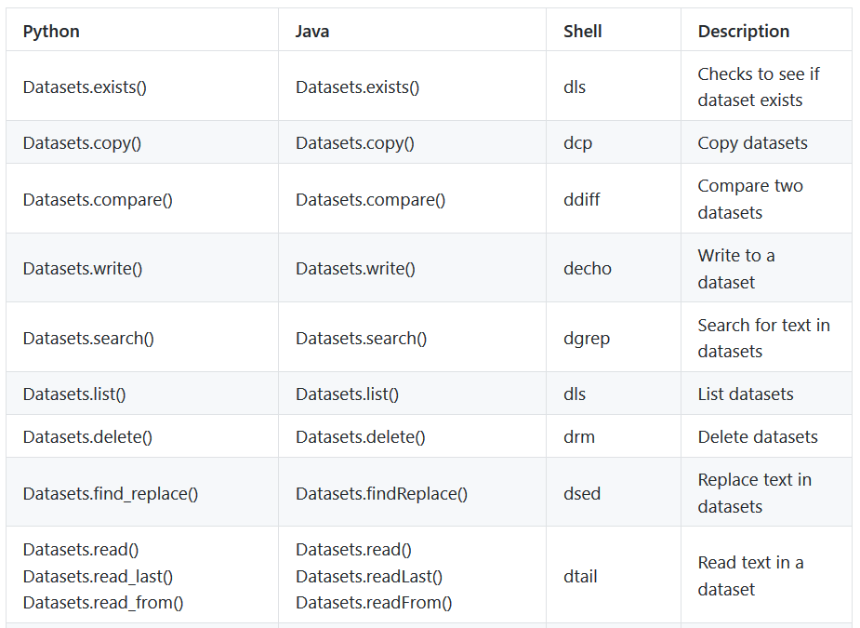
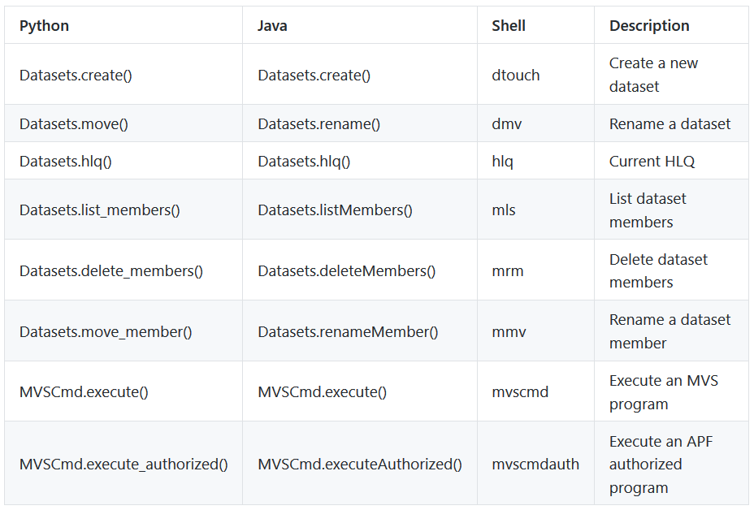
ZOA Utilities v1.0 Commands

Slide 13
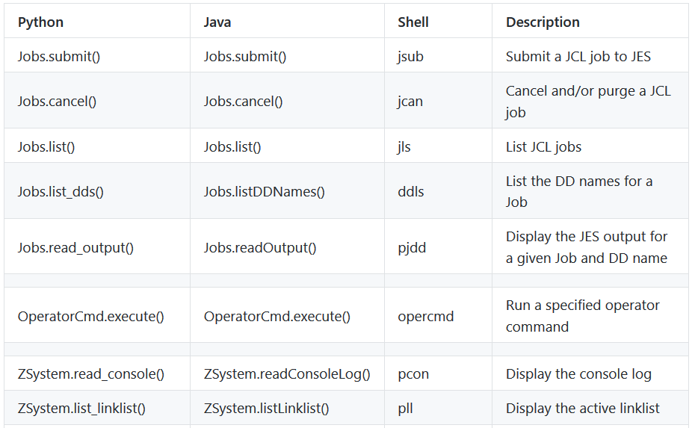
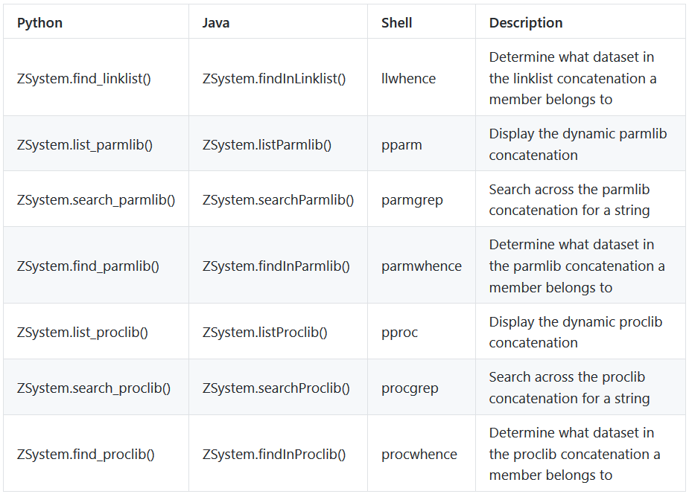
New Commands Under Development

Slide 14
Availability
The ZOA Utilities is packaged as part of the latest versions of the following products:
IBM Application Delivery Foundation for z Systems
IBM Developer for z Systems Enterprise Edition
IBM Z Open Development
IBM Dependency Based Build

Slide 15
ZOA Utilities Knowledge Center
https://www.ibm.com/support/knowledgecenter/SSKFYE_1.0.0/welcome_zoautil.html
Table of contents include:
Functional Overview
Installation and configuration
Example of merging data sets in each supported language
Instructions on extending ZOA Utilities to other languages
Command and API references
Messages reference

Slide 16
Debugging – Common Problems
Q: What shall I do to cope with the following message?
FSUM7332 syntax error: got (, expecting Newline
A: This might happen if you do not set _BPXK_AUTOCVT. To fix this, make sure that you have issued the following command before running the utilities:
export _BPXK_AUTOCVT=ON
Q: I cannot use the dls, dmv, mmv, mrm or dlsraw commands. How can I fix it?
A: If commands such as dls, dmv, mmv, mrm or dlsraw fail for you, but other commands work, check whether you have mvscmdauth installed correctly as follows:
Issue type -a mvscmdauth to determine where mvscmdauth is installed. In this example, we assume that mvscmdauth is installed in /usr/lpp/IBM/zoautil.
Issue ls -E /usr/lpp/IBM/zoautil. If mvscmdauth is installed correctly, the first two columns read like -rwxr-xr-x a---. In particular, if the ‘a’ is not present, mvscmdauth is not APF-authorized. To set the APF authorization bit on, issue extattr +a /usr/lpp/IBM/zoautil. If it is still not set afterward, you probably do not have permission to do it, and you should consult your systems programmer.

Slide 17
Thank You

